Slide 1

Somnolence Detection for Vehicular Aid
National Institute of Technology, Srinagar
Information Technology Department
Akansha Agarwal - IT/59/15
Mohit Verma - IT/44/15
Project guide: Ms. Iqra Altaf Gillani

Slide 2
Outline
Introduction
Motivation
Literature Survey
Features used
Block diagram of the Model Used
Explanation of the Block Diagram
Results
Future Work

Slide 3
Introduction
With constantly increasing drowsiness associated accidents, an effective and efficient automated system is need of the hour.
Compared to driving under the influence of alcohol, drowsy drivers may pose an equal, if not greater threat.
In this project, our main motive is to build an automated system which can detect drowsiness in drivers with decent efficiency.

Slide 4
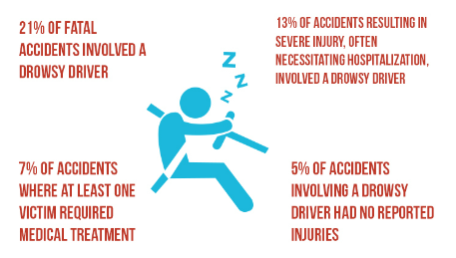
Motivation
The National Highway Traffic Safety Administration (NHTSA) estimates that drowsy driving is a factor in 100,000 crashes, resulting in nearly 80,000 injuries, and 6,550 deaths annually.
These crashes due to drowsiness are constantly increasing and we are in an urgent need of a solution.

Slide 5
Literature Survey
Name | Author | Feature/Description
Drowsy driver detection using representation learning. (2014) | Kartik Dwivedi, Kumar Biswaranjan, and Amit Sethi. | Normalisation, Image Subtraction and Neural Networks
Real-time driver drowsiness detection for embedded system using model compression of deep neural networks. (2017) | Bhargava Reddy, Ye-Hoon Kim, Sojung Yun, Chanwon Seo, and Junik Jang | Multi-Task Cascaded Convolutional Networks (MTCNN) for Face Detection and Driver Drowsiness Detection Network (DDDN) for drowsiness detection
Driver fatigue detection using mouth and yawning Analysis. (2008) | Mandalapu Saradadevi and Preeti Bajaj | Face Detection, Mouth Extraction and SVM for Classification

Slide 6
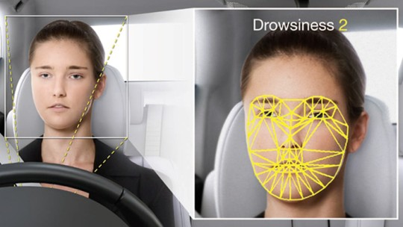
Features used
Eye closure.
Mouth and Yawning Analysis.
Head Leaning Forward.
Hand Movements (Coverage of face)

Slide 7
Block Diagram of the Neural Network Model
Head Bent Detection Model(HBDM)
Yawning Detection Model(YDM)
Input Video
Conversion to frames
Internal Engine
Internal Engine
Final Results
Eye Closure Detection Model(ECDM)
Face coverage Detection Model(FCDM)

Slide 8
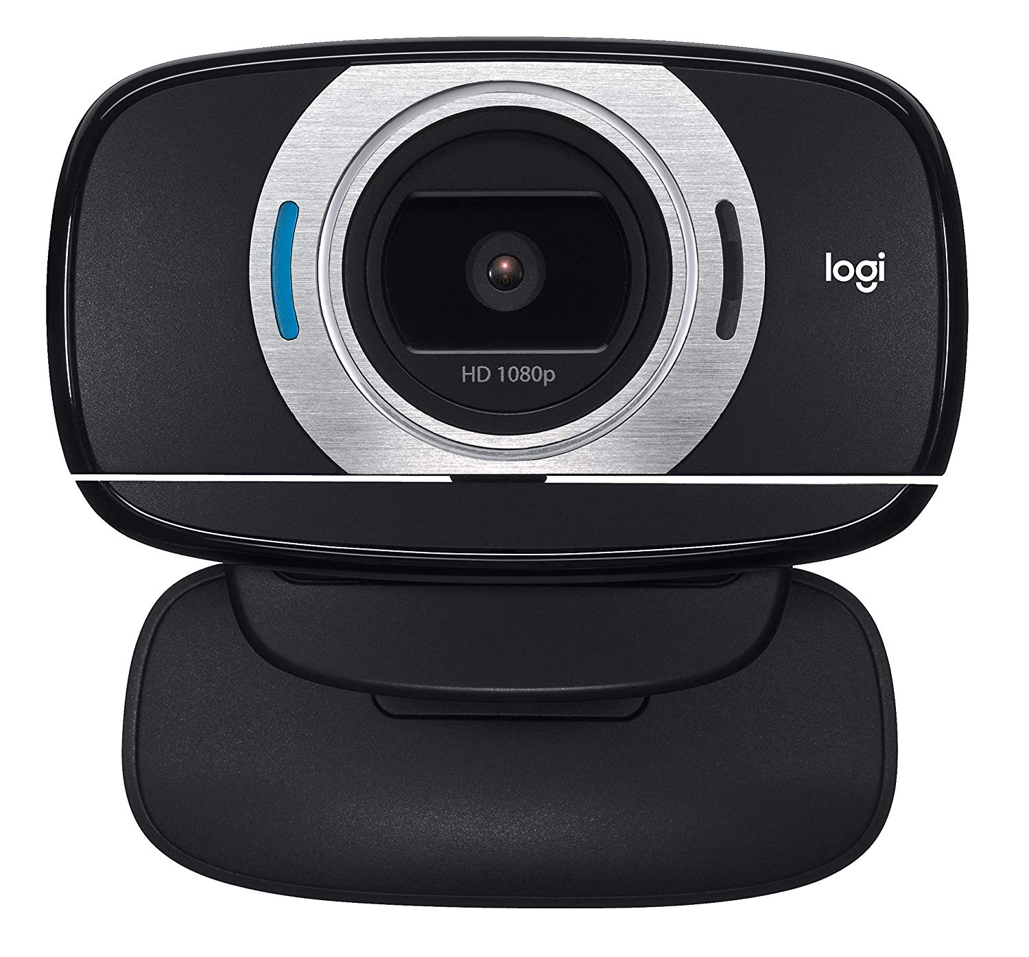
Video Input
We used Logitech Full HD C615 camera to capture video inputs of driver.

Slide 9
Progress
Head Bent Detection Model(HBDM)
Yawning Detection Model(YDM)
Input Video
Conversion to frames
Internal Engine
Internal Engine
Final Results
Eye Closure Detection Model(ECDM)
Face coverage Detection Model(FCDM)

Slide 10
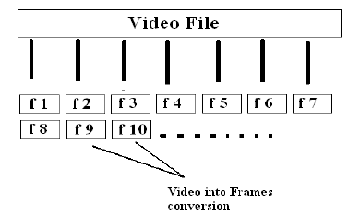
Conversion to Frames
Our model works on images and not on videos, so as soon as video is recorded, we need to convert that video into frames using frame extraction present in OpenCV.
Our camera records at an rate of 30fps so at the time of frame extraction we get 30 frames for a video of 1 second.

Slide 11
Progress
Head Bent Detection Model(HBDM)
Yawning Detection Model(YDM)
Input Video
Conversion to frames
Internal Engine
Internal Engine
Final Results
Eye Closure Detection Model(ECDM)
Face coverage Detection Model(FCDM)

Slide 12
Internal Engine
Internal Engine is an abstraction of the main program which in the initial phase feeds all neural networks with the frames which are extracted from the video.
Internal Engine manages all the input/output related jobs and maintains all four models which will be explained later.
All the job regarding image pre-processing is performed here and images are made suitable for training, testing and prediction purpose

Slide 13
Progress
Head Bent Detection Model(HBDM)
Yawning Detection Model(YDM)
Input Video
Conversion to frames
Internal Engine
Internal Engine
Final Results
Eye Closure Detection Model(ECDM)
Face coverage Detection Model(FCDM)

Slide 14

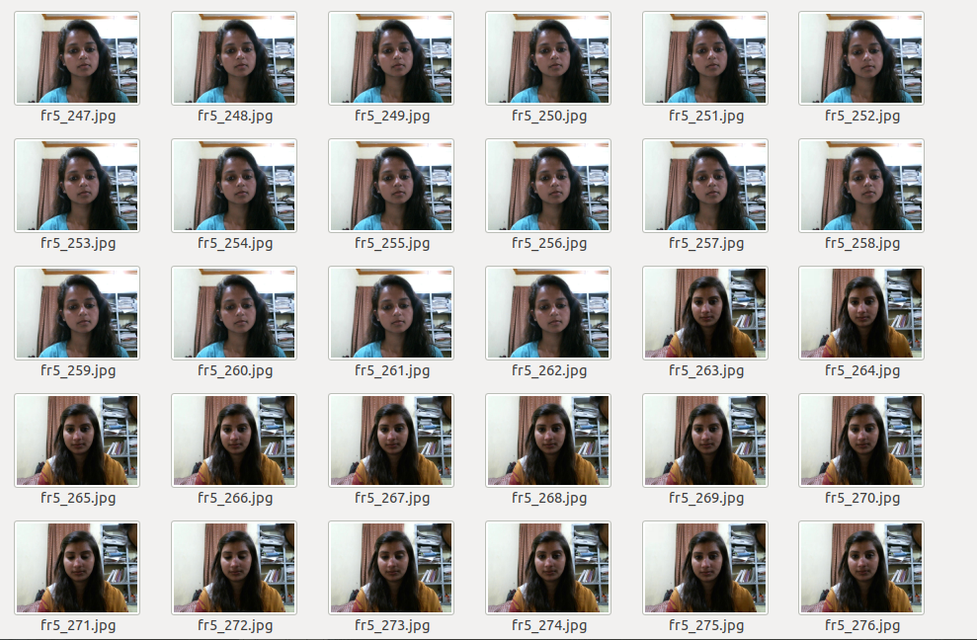
Head Bent Detection Model
Dataset for Head Bent Detection Model

Slide 15
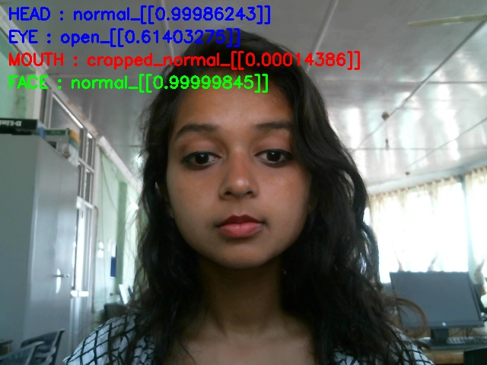
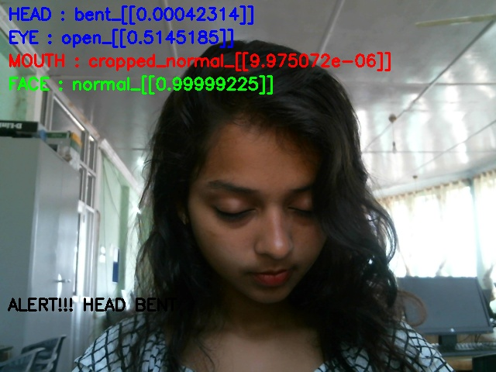
Result of Head Bent Detection Model

Slide 16
Progress
Head Bent Detection Model(HBDM)
Yawning Detection Model(YDM)
Input Video
Conversion to frames
Internal Engine
Internal Engine
Final Results
Eye Closure Detection Model(ECDM)
Face coverage Detection Model(FCDM)

Slide 17
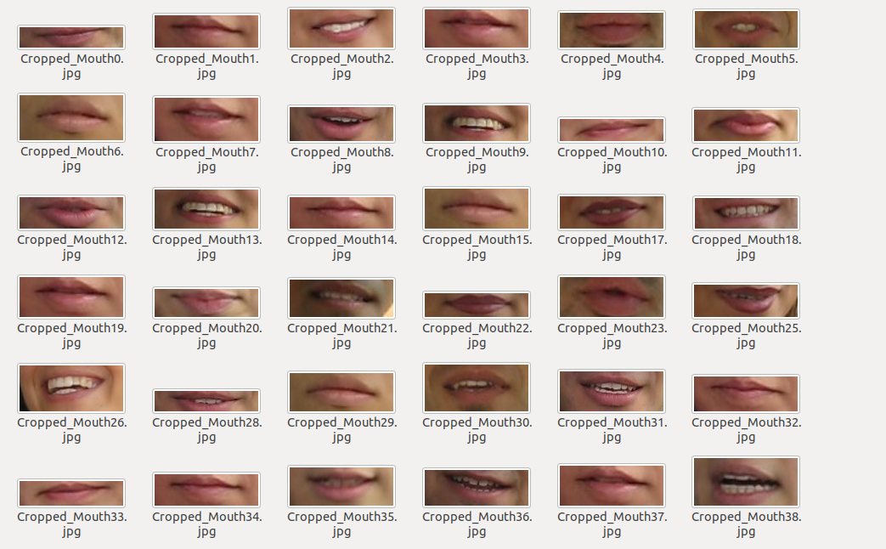
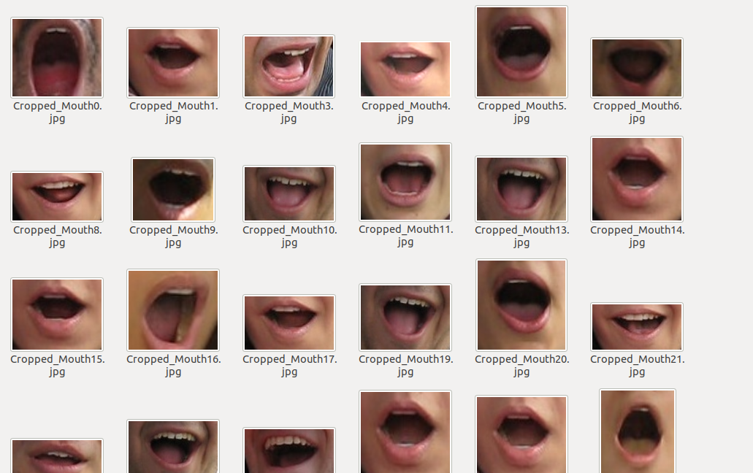
Yawning Detection Model
Dataset for Yawning Detection Model

Slide 18
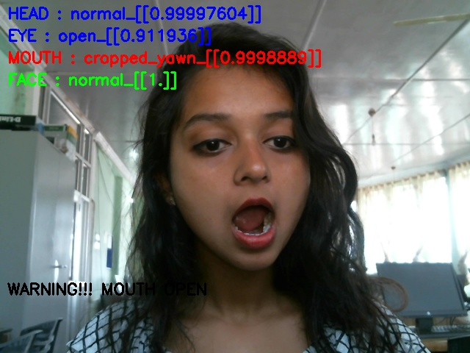
Result of Yawning Detection Model

Slide 19
Progress
Head Bent Detection Model(HBDM)
Yawning Detection Model(YDM)
Input Video
Conversion to frames
Internal Engine
Internal Engine
Final Results
Eye Closure Detection Model(ECDM)
Face coverage Detection Model(FCDM)

Slide 20
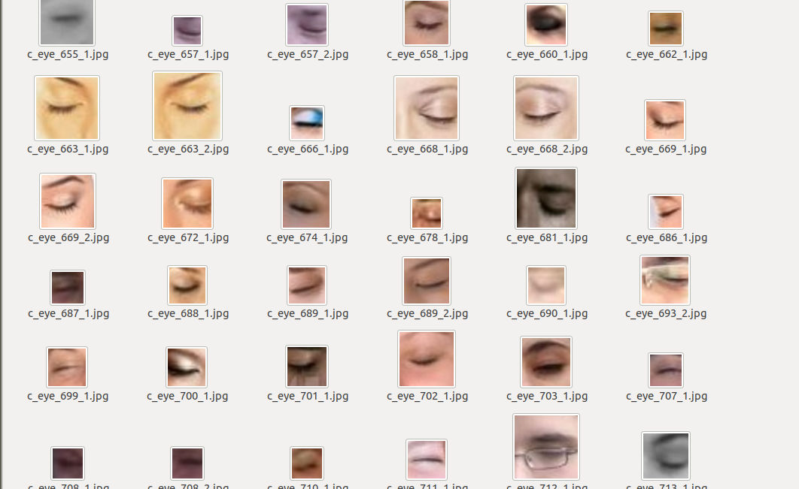
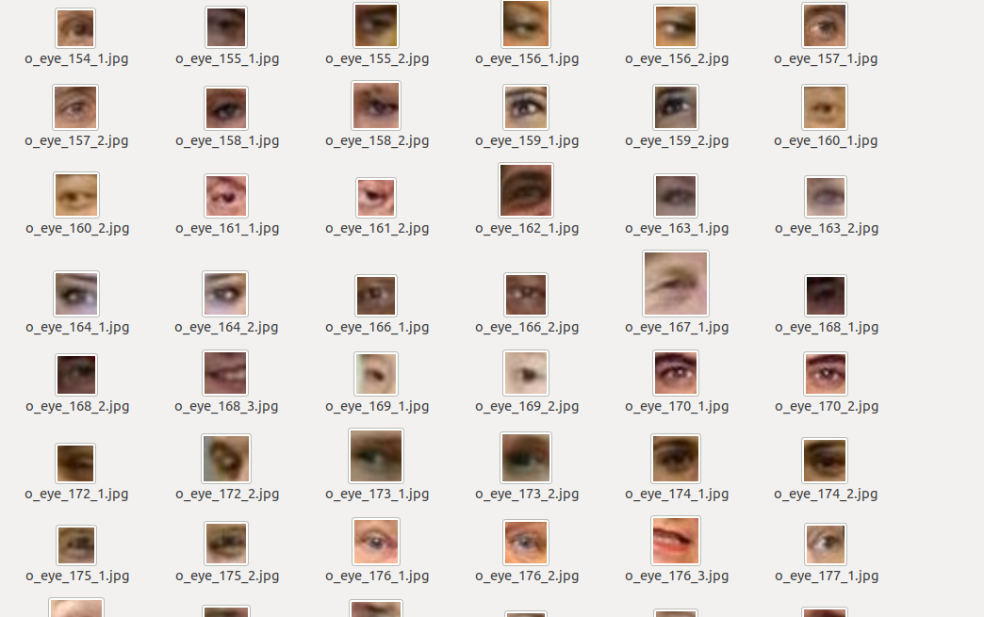
Eye Closure Detection Model
Dataset for Eye Closure Detection

Slide 21
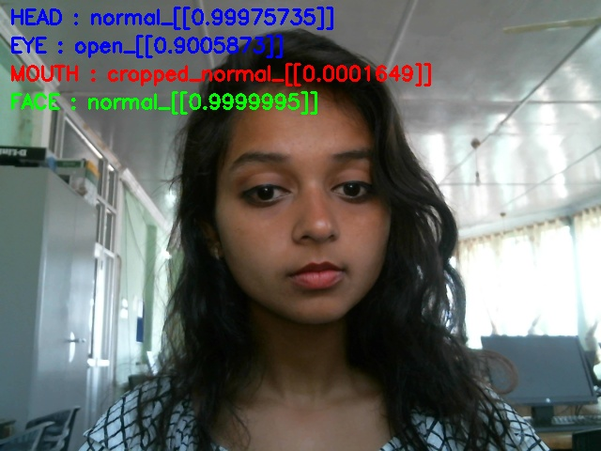
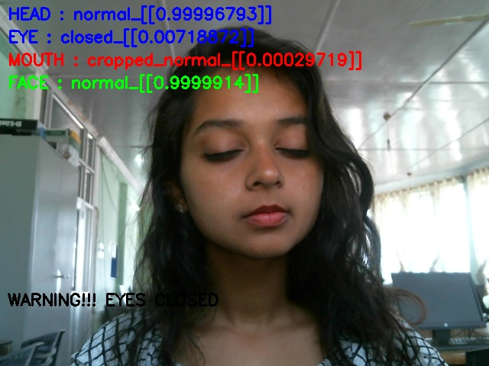
Result of Eye Closure Detection Model

Slide 22
Progress
Head Bent Detection Model(HBDM)
Yawning Detection Model(YDM)
Input Video
Conversion to frames
Internal Engine
Internal Engine
Final Results
Eye Closure Detection Model(ECDM)
Face coverage Detection Model(FCDM)

Slide 23
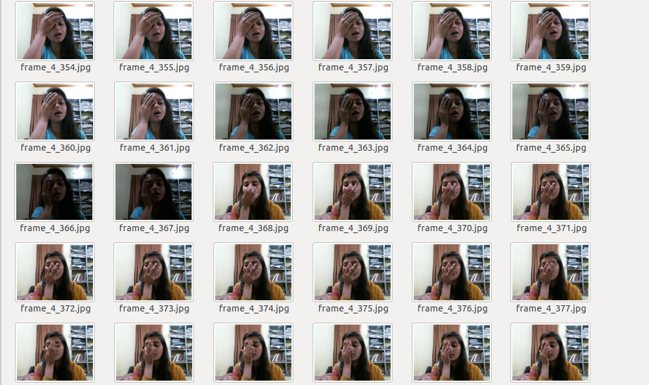
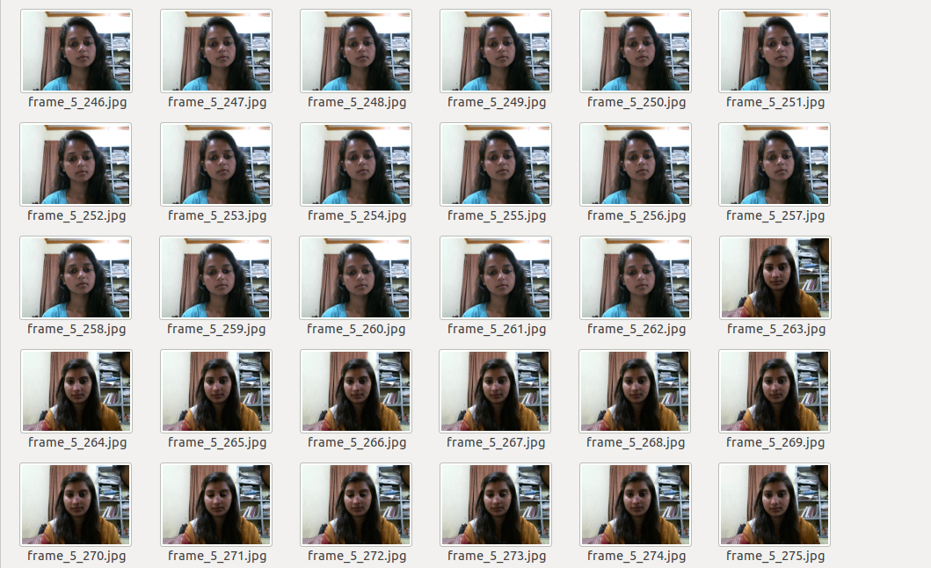
Face Coverage Detection Model
Dataset for Face Coverage Detection Model

Slide 24
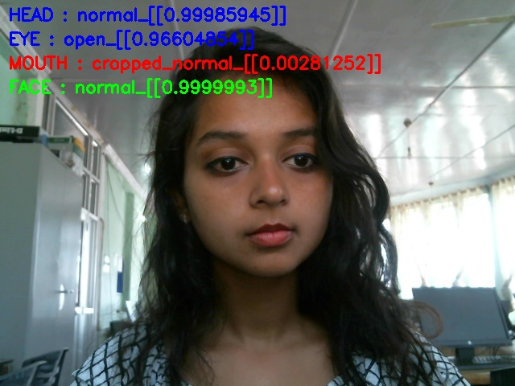
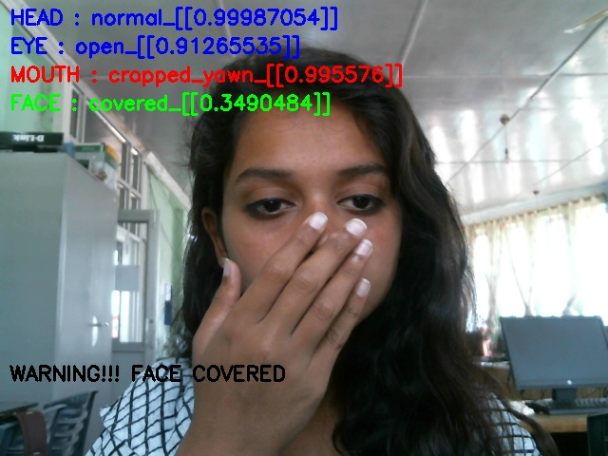
Result of Face Coverage Detection Model

Slide 25
Progress
Head Bent Detection Model(HBDM)
Yawning Detection Model(YDM)
Input Video
Conversion to frames
Internal Engine
Internal Engine
Final Results
Eye Closure Detection Model(ECDM)
Face coverage Detection Model(FCDM)

Slide 26
Internal Engine
Head Bent or Not?
Yawning or Not?
Eyes Closed or Not?
Face Covered or Not?
Drowsy or Not?

Slide 27
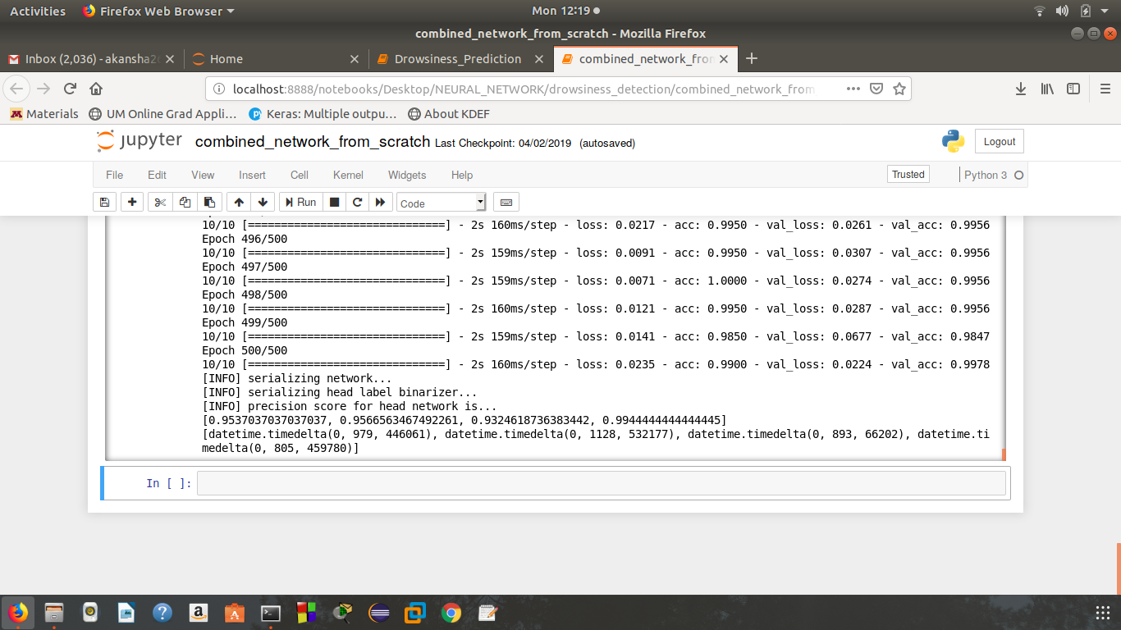
Accuracy of the Models

Slide 28
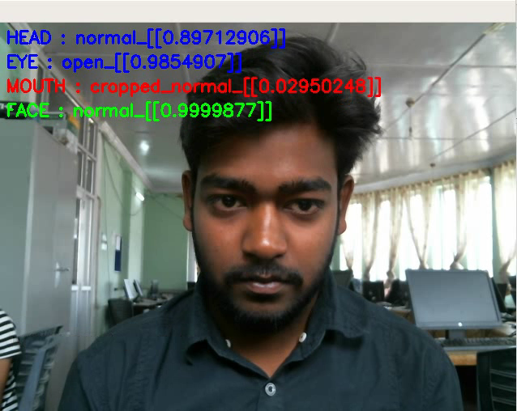
Final Results

Slide 29
Future Work
Use of Intrusive methods like pulse rate, heat beats etc. Introduction of BAN(Body Area Network) for measuring intrusive features.
Observation of driver’s driving behaviour to check the usage of brakes, clutch and accelerator.
Use of Infrared Camera for better extraction of mouth and eyes.

Slide 30
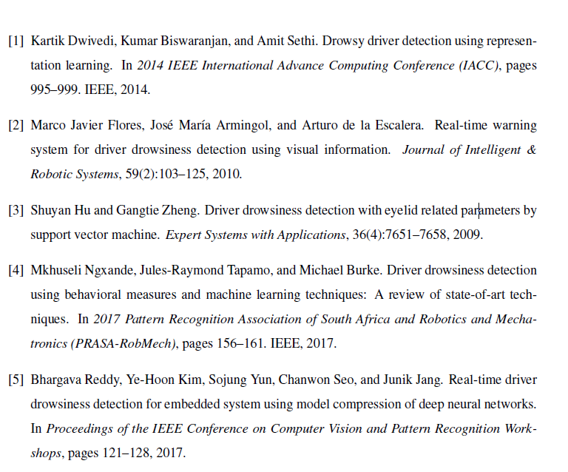
References

Slide 31
Thanks !

